Slide 1
Text Search based on Spark
for Children Books
DPW II 1001
Group 5
谢欣言 1930026136
焦海旭 1930026057
徐贺 1930026139

Slide 2
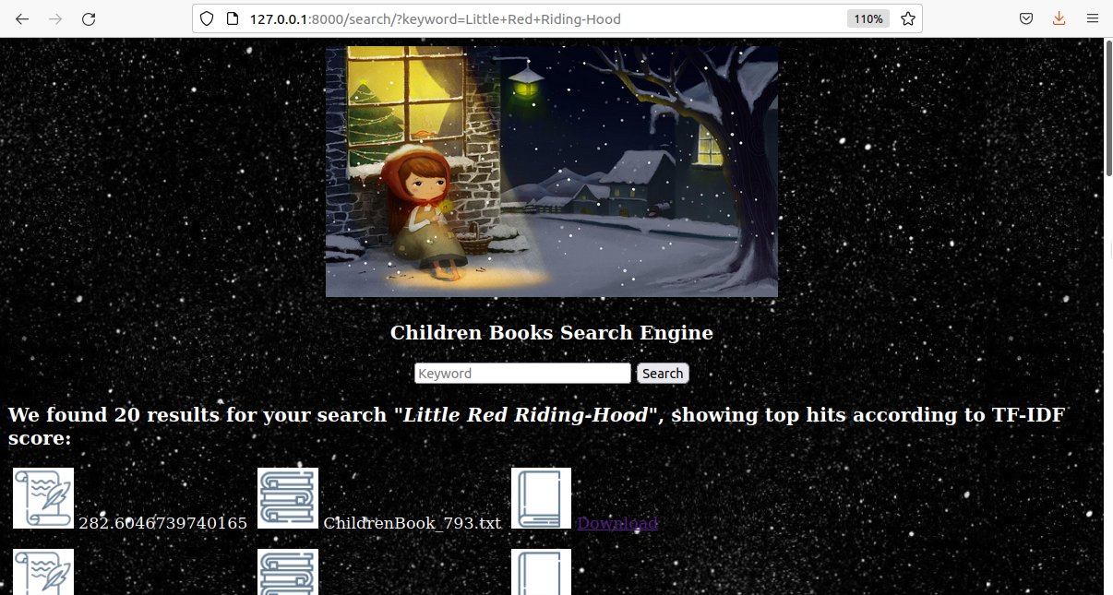
Project Background and Goals
Therefore, we use the HDFS and Spark analytic and computing methods to build a search engine to allow them to find, download, and read the books containing the content they want to read quickly.
Nowadays, there is a huge amount of book resources on the Internet, and for readers, especially for children, it is extremely difficult to find and read what they want.

Slide 3
Contents
Text Files Collection
Indexing and Ranking
Web Server and Interface
1
2
3

Slide 4
1. Text Files Collection

Slide 5
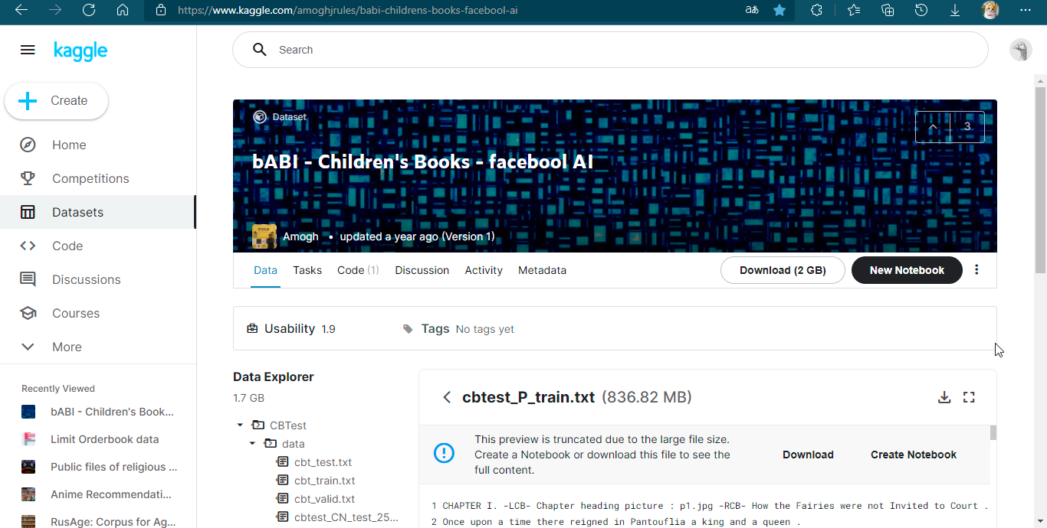
Resource
Our data are collected from Kaggle: https://www.kaggle.com/amoghjrules/babi-childrens-books-facebool-ai

Slide 6
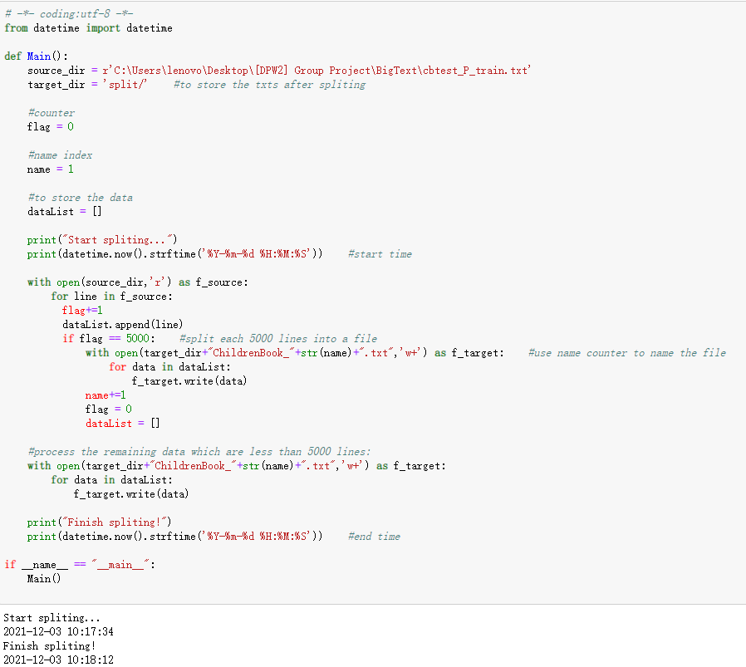
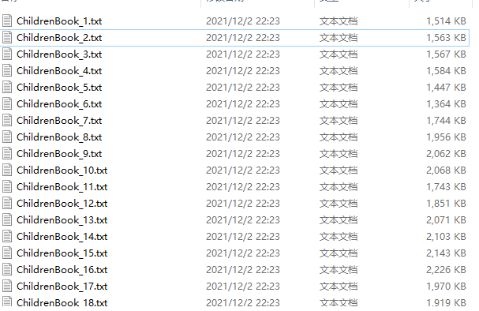
Data preprocessing
Split into small files:
(so that users can find and read a specific small book)
tur

Slide 7
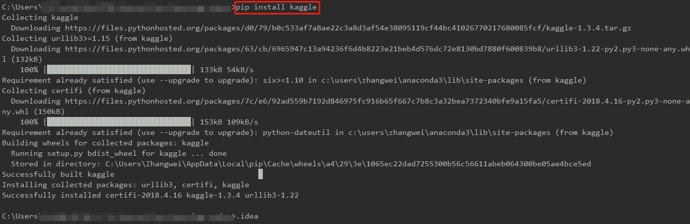

Discuss:
methods to speed up data collection:
Use web crawler
Use Python “kaggle” Package
Download a big one and split

Slide 8


Prepare test (small) files
1GB
100MB

Slide 9
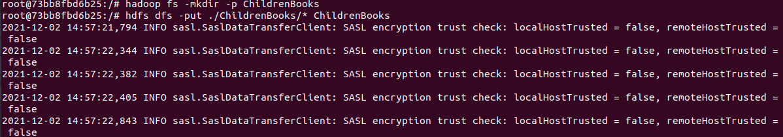
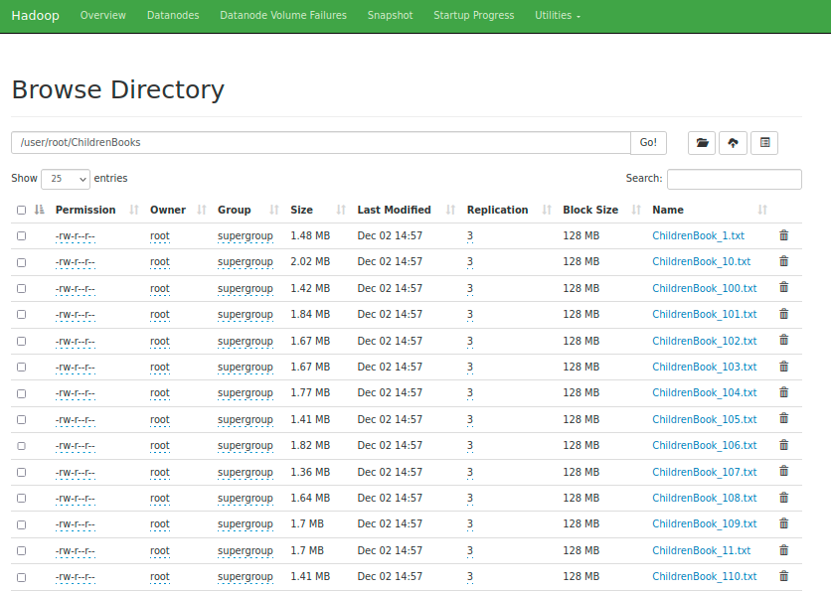
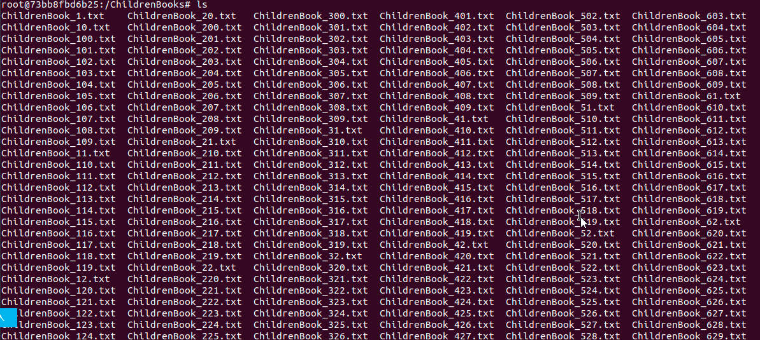
Put on HDFS
Copy to HDFS
Put on Namenode

Slide 10

Discuss:
how to update the results in real time:
If we get our data from websites or social media, we can fetch and update the new content every hour (or 24h for slow updates), reconstruct the inverted index and recalculate the sorting to update our search results.
However, for our system, we need to add new files or update files on HDFS manually, instead of fetching it automatically and then recalculating index.

Slide 11
2. Indexing and Ranking

Slide 12
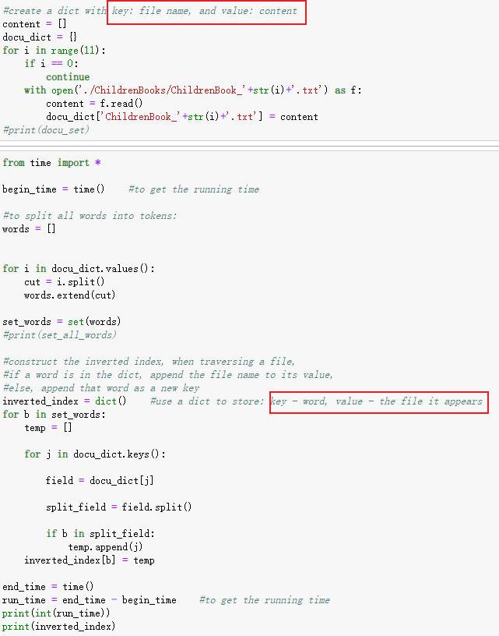
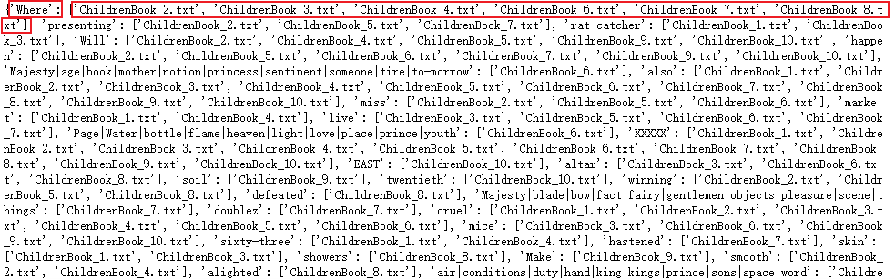
Indexing
On single node and no MapReduce:

Slide 13
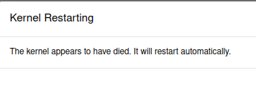
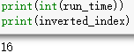
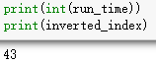
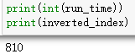
Indexing
On single node and no MapReduce:
For small files:
For large files (1GB):
Extremely slow!!!
2files: 16s
3files: 43s
10files: 13.5min
Cannot run

Slide 14
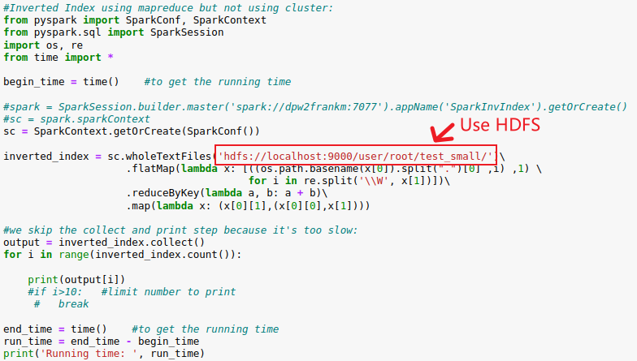
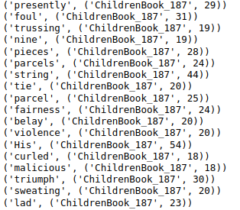
Indexing
On single node and using MapReduce:

Slide 15
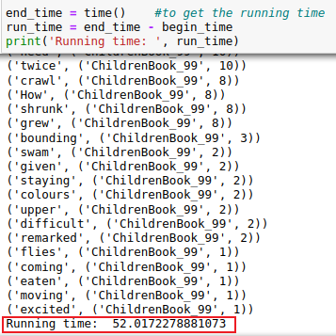
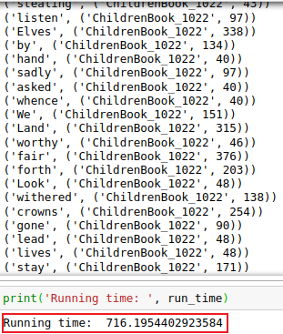
Indexing
On single node and using MapReduce:
For small files (100MB):
For large files (1GB):
52s
12min

Slide 16
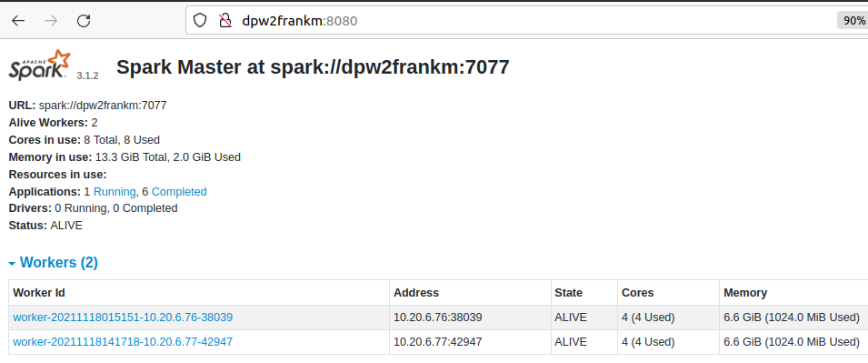
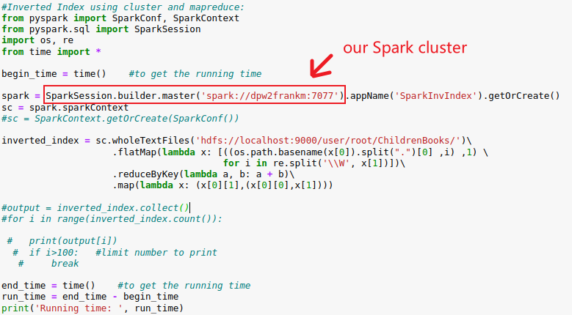

Indexing
Using MapReduce and Spark Cluster:
1 master and 2 workers

Slide 17
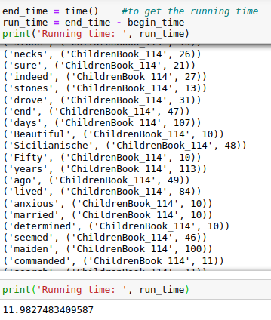
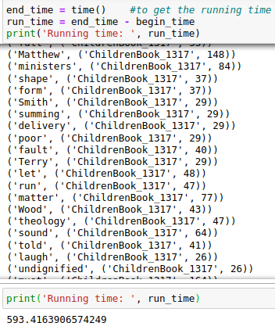
Indexing
Using MapReduce and Spark Cluster:
For small files (100MB):
For large files (1GB):
11s
10min

Slide 18

Indexing
Compare the performance:
11s
Spark, MapReduce, Small files
52s
Single node, MapReduce, Small files
10min
Spark, MapReduce, Large files
12min
Single node, MapReduce, Large files
More than 1h
No Spark & Mapreduce, Small files
Cannot run
No Spark & Mapreduce, Large files

Slide 19
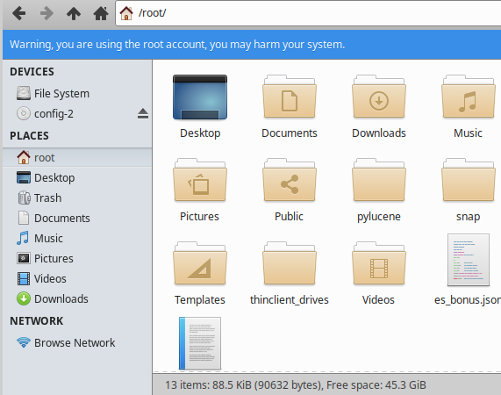
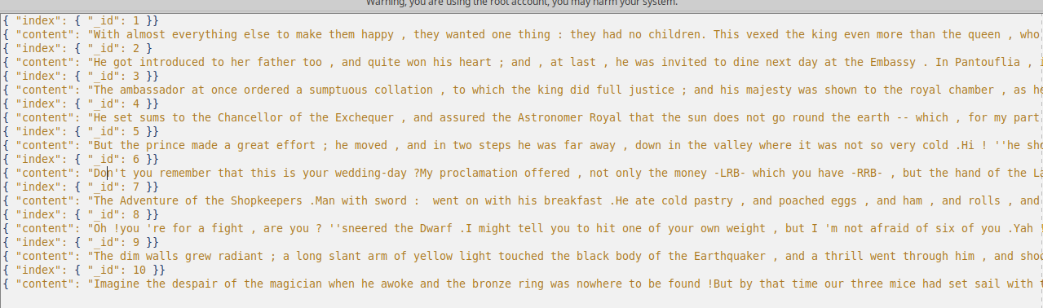


Inverted Index based on ElasticSearch
File:
txt.
json.
Uploading in Es engine, terminal Code:
$ curl -H 'Content-Type: application/x-ndjson' -XPOST ‘localhost:9200/es/_bulk?pretty' --data-binary @es_bonus.json

Slide 20
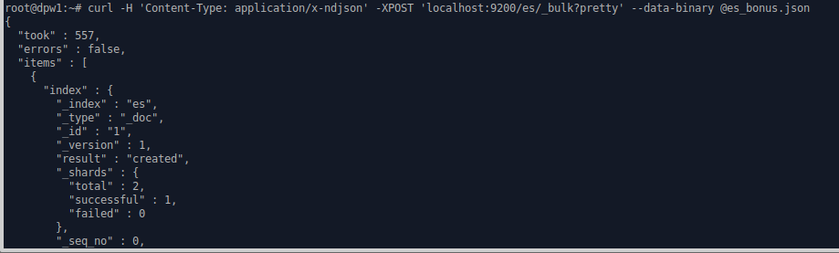
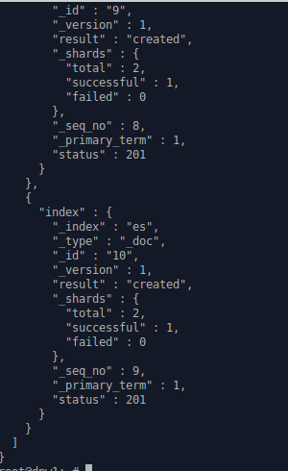
Successfully upload!
And move on to do Inverted Index on Jupyter notebook

Slide 21
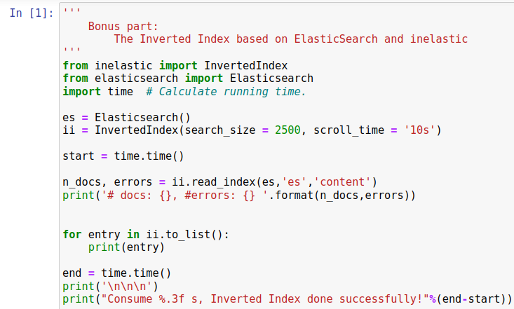
Inverted Index based on ElasticSearch
inelastic builds an approximation of how an inverted index would look like for a particular index and document field
The inelastic module exposes the InvertedIndex class

Slide 22
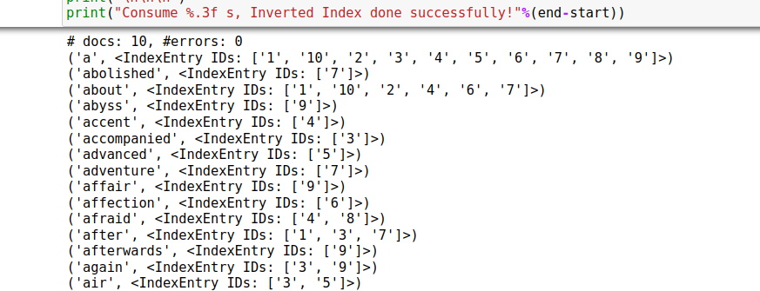
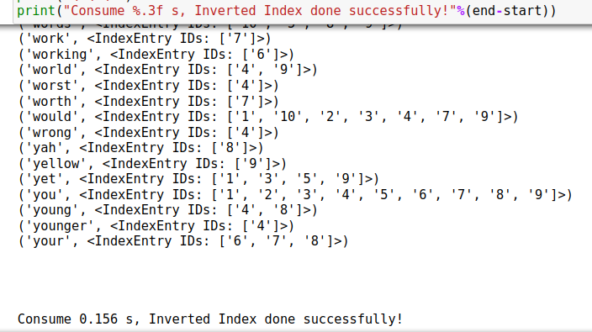
Result

Slide 23
Another way to obtain the
Inverted Index
Type code in terminal:
$ inelastic -i es -f content | column -t -s

Slide 24
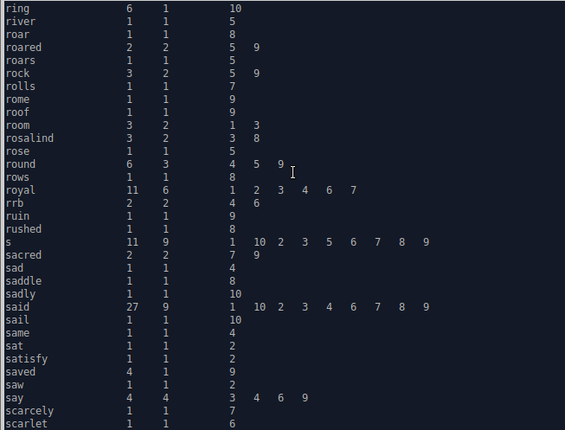
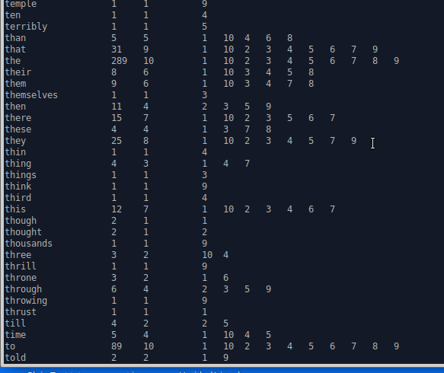
Result
doc_count
freq
Referred file
24

Slide 25
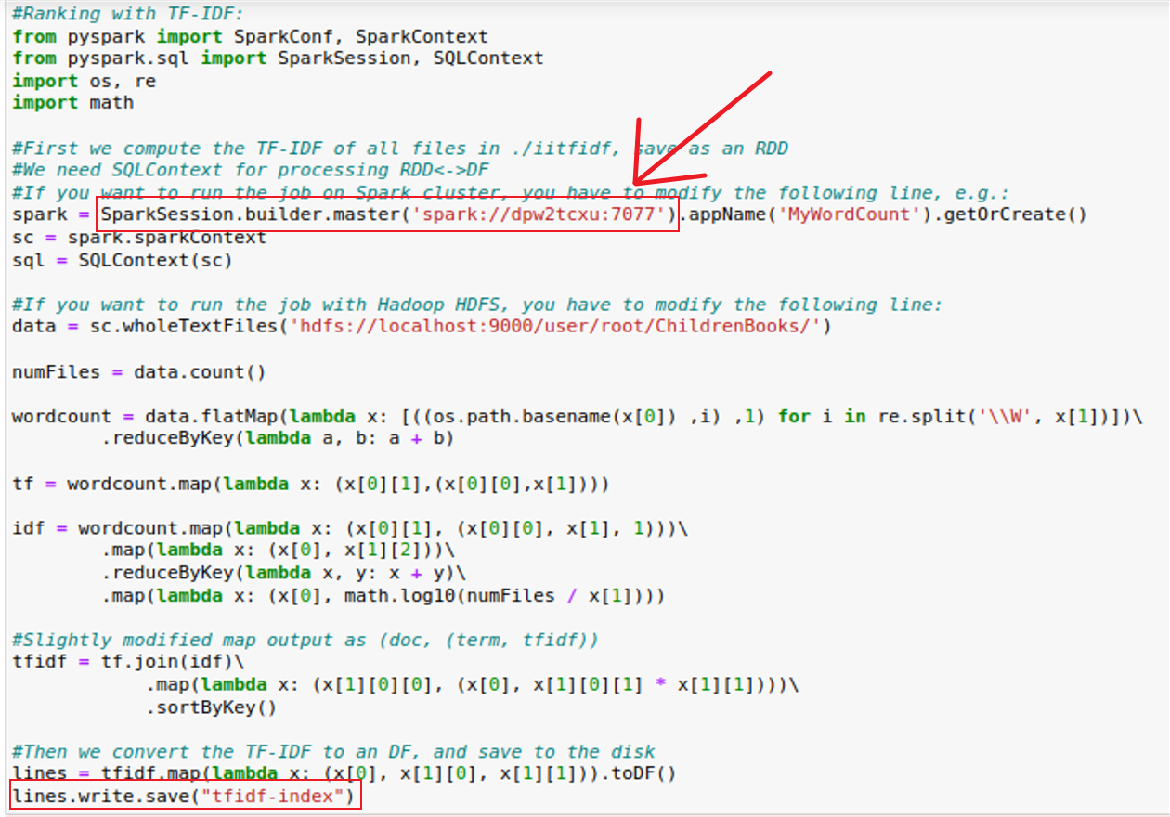
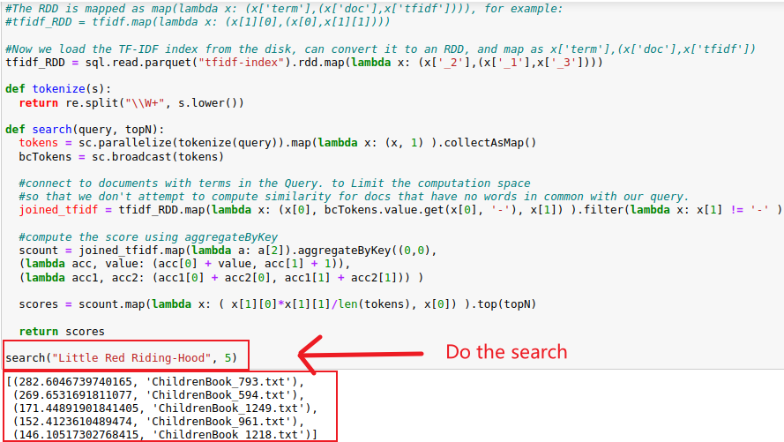
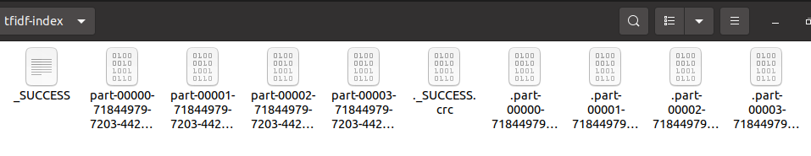
Ranking
Using Spark

Slide 26
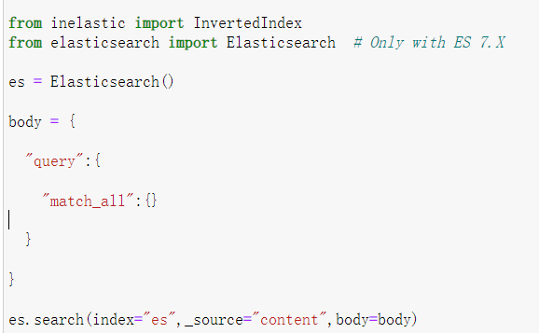
Ranking
Using Elasticsearch
query:
search for the data according to the created index

Slide 27
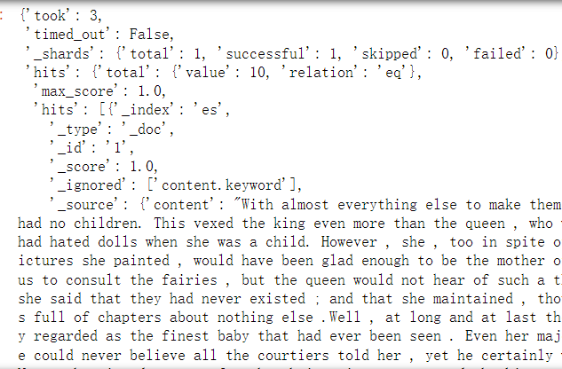
Ranking
Using Elasticsearch
some import
attribution:
took
hits.total
hits.hits

Slide 28
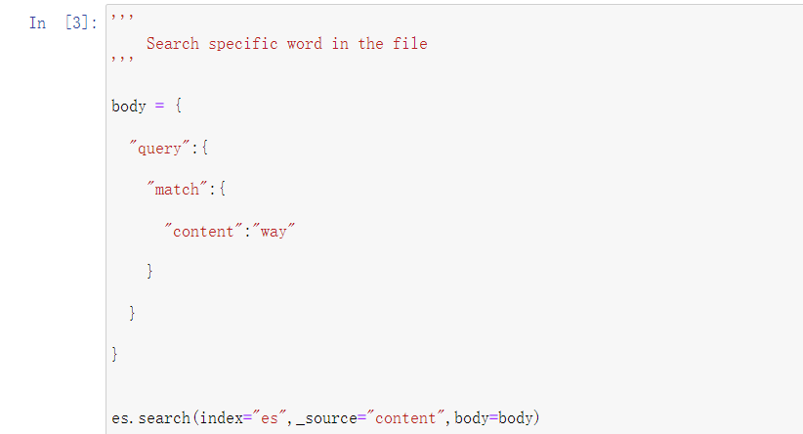
Ranking
Using Elasticsearch
Then we use match for searching:
searching for the file where the matching word in the “content” is located

Slide 29
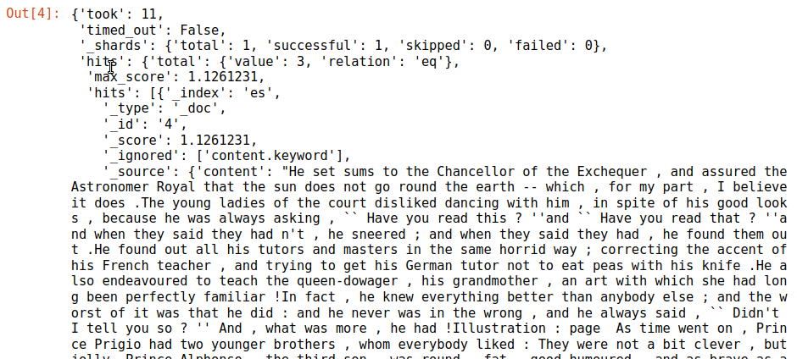
Ranking
Using Elasticsearch
This is the result after we searching for the word “way”.

Slide 30
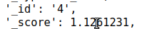
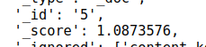
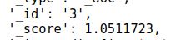
Ranking
Using Elasticsearch
sorted by the value of _score
Term frequency
inverse document frequency
the normalized values of document frequency

Slide 31
3. Web Server and Interface

Slide 32
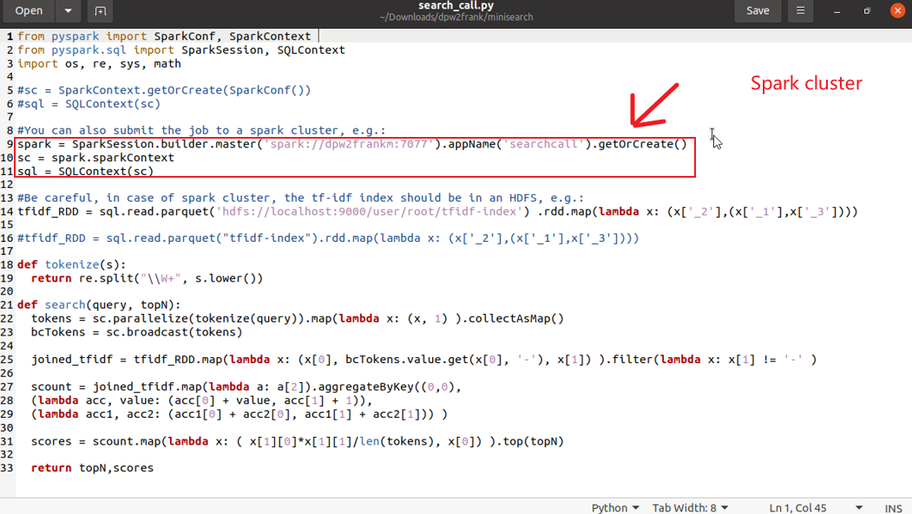
Web Interface
search_all.py

Slide 33
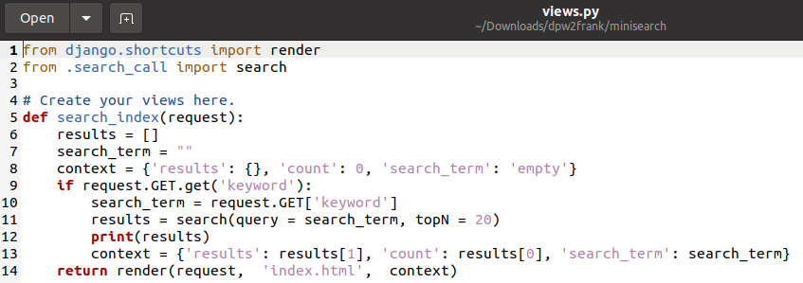
Web Interface
views.py

Slide 34
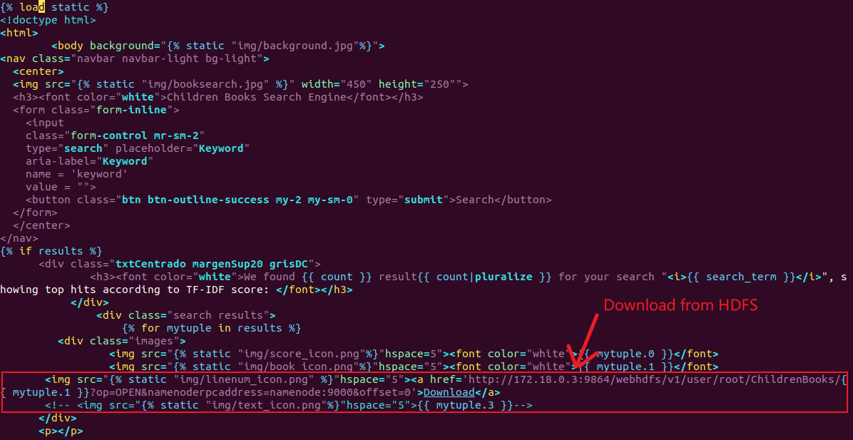
Web Interface
index.html

Slide 35
Web Interface
Let me show you……

Slide 36
Thanks!

